Slide 1
Session 8-10: Network Devices – Hub, Switch, and Router

Slide 2
Networking devices
Inside a network
Hub: Older device
Switch: Modern device
To connect different networks
Router

Slide 3
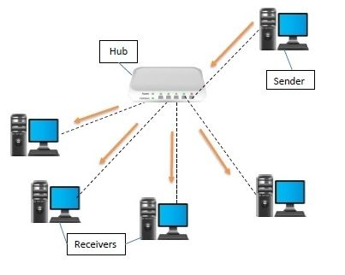
Hub
Earlier, hubs were used as connection devices in Ethernet
Hub is a dumb device, works only at the physical layer (Layer 1)
So, it does not know about MAC addresses, and hence floods out all the ports
All devices that use the same physical media and listen to each frame are considered to be in the same collision domain

Slide 4
Switch
Hubs are obsolete
Switch is an intelligent device – can filter traffic
Example
If a hub connects two branches of a network, it will flood both the branches for every received frame
A switch will check whether it should send it to the other branch of the network by comparing addresses, as discussed shortly

Slide 5
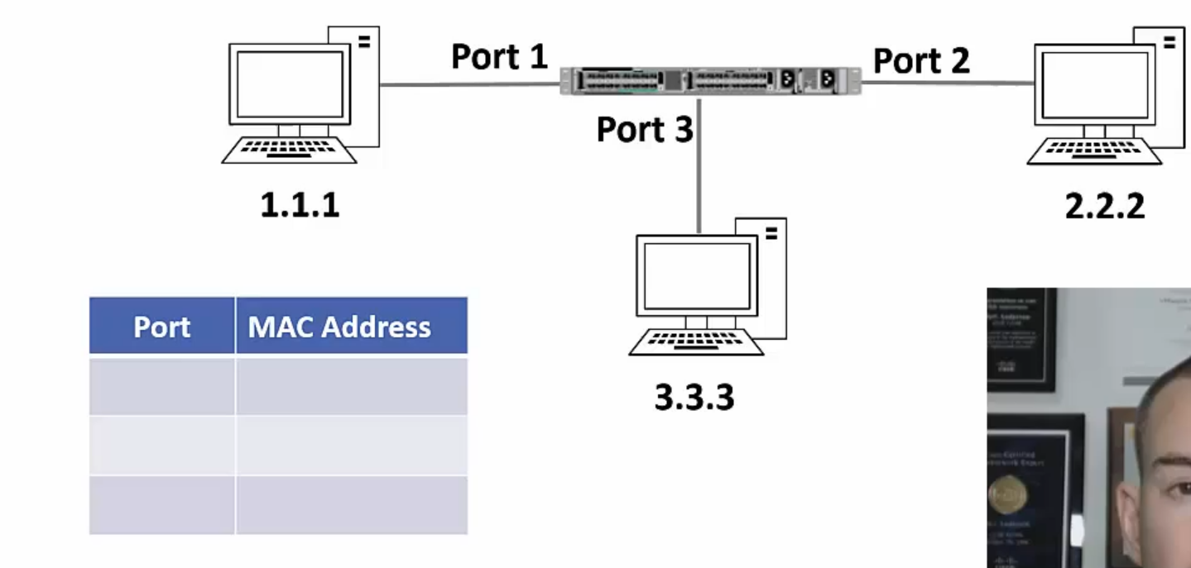
Switching Example – 1
Each switch maintains a mapping table

Slide 6
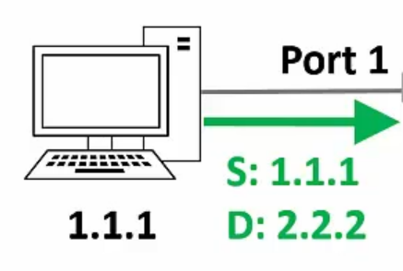
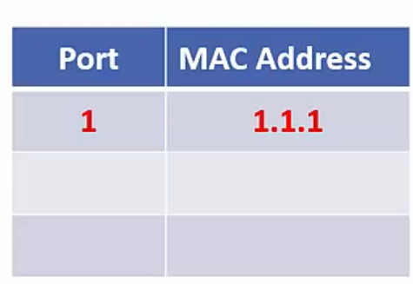
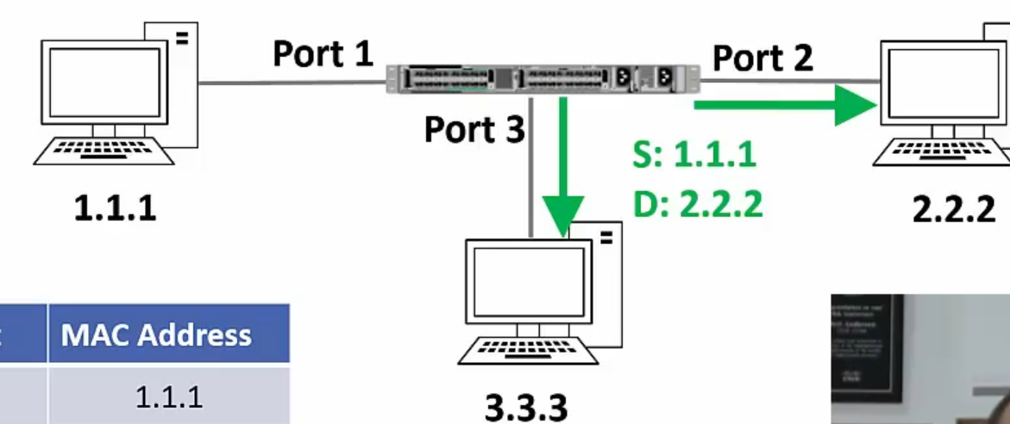
Switching Example – 2
Host 1.1.1 sends a frame to host 2.2.2
Switch sees the frame and updates its mapping table
The switch does not know where 2.2.2 is, so it floods out the frame
`

Slide 7
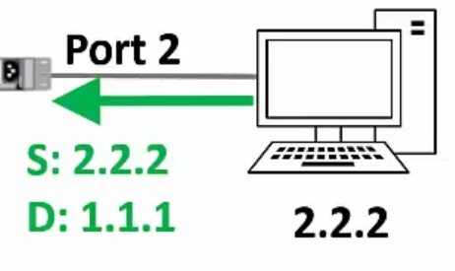
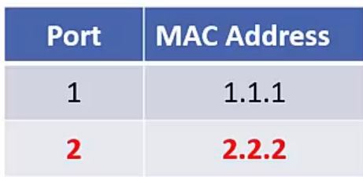
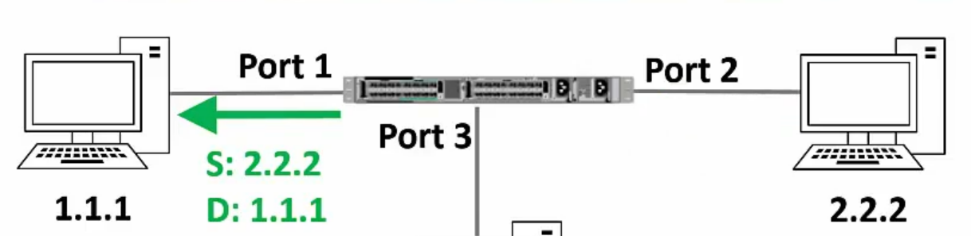
Switching Example – 3
Suppose host 2.2.2 sends a reply to 1.1.1
Switch sees the frame and updates its mapping table
The switch will send the frame only to 1.1.1

Slide 8
Router
A router works at layer 3 (network layer) and uses IP addresses to decide where to deliver packets
Remember: A switch works at layer 2 (data link layer) and uses MAC addresses to decide where to deliver packets
Device | Layer | Uses
Router | 3 (Network) | IP addresses
Switch | 2 (Data link) | MAC addresses

Slide 9
Routing
Routing means taking a packet from one device and sending it through the network to another device on a different network
Switching means taking a packet from one device and sending it through the network to another device on the same network
A switch can be used for sending traffic inside a network
For sending traffic outside a network we need a router

Slide 10
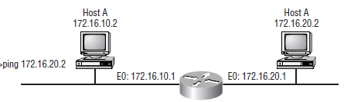
Routing Example
B
Host A and B are on different networks
On a command prompt, the user types ping 172.16.20.2
A packet is generated on the Host A machine using the Internet Protocol (IP)
Host A sends this packet to the router
The router opens the packet and understands that the destination host B is not on the same network
Router forwards the packet to host B
Note: Several additional steps are needed for this, which are not described here for simplicity

Slide 11
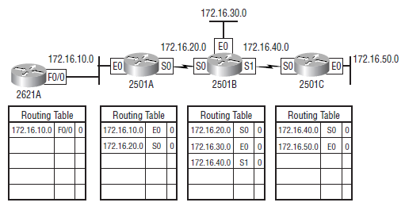
Routing Table
To perform routing, a router needs to build a routing table – Initial state

Slide 12
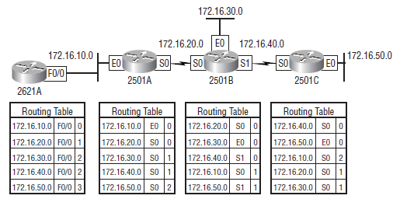
Routing Table after it is Updated
Called as converged routing table

Slide 13
Hubs versus Switches versus Routers
Hub | Switch | Router
Operates at layer 1 (Physical layer) | Operates at layer 2 (Data link layer) | Operates at layer 3 (Network layer)
Works inside a LAN | Works inside a LAN | Works across networks
Generally works only for Ethernet | Generally works only for Ethernet | Supports Ethernet, ISDN, ADSL, etc
Has many ports | Has more ports | Has less ports
A dumb device – floods out all the ports; so does not know about MAC or IP addresses | Works with MAC addresses | Woks with IP addresses

Slide 14

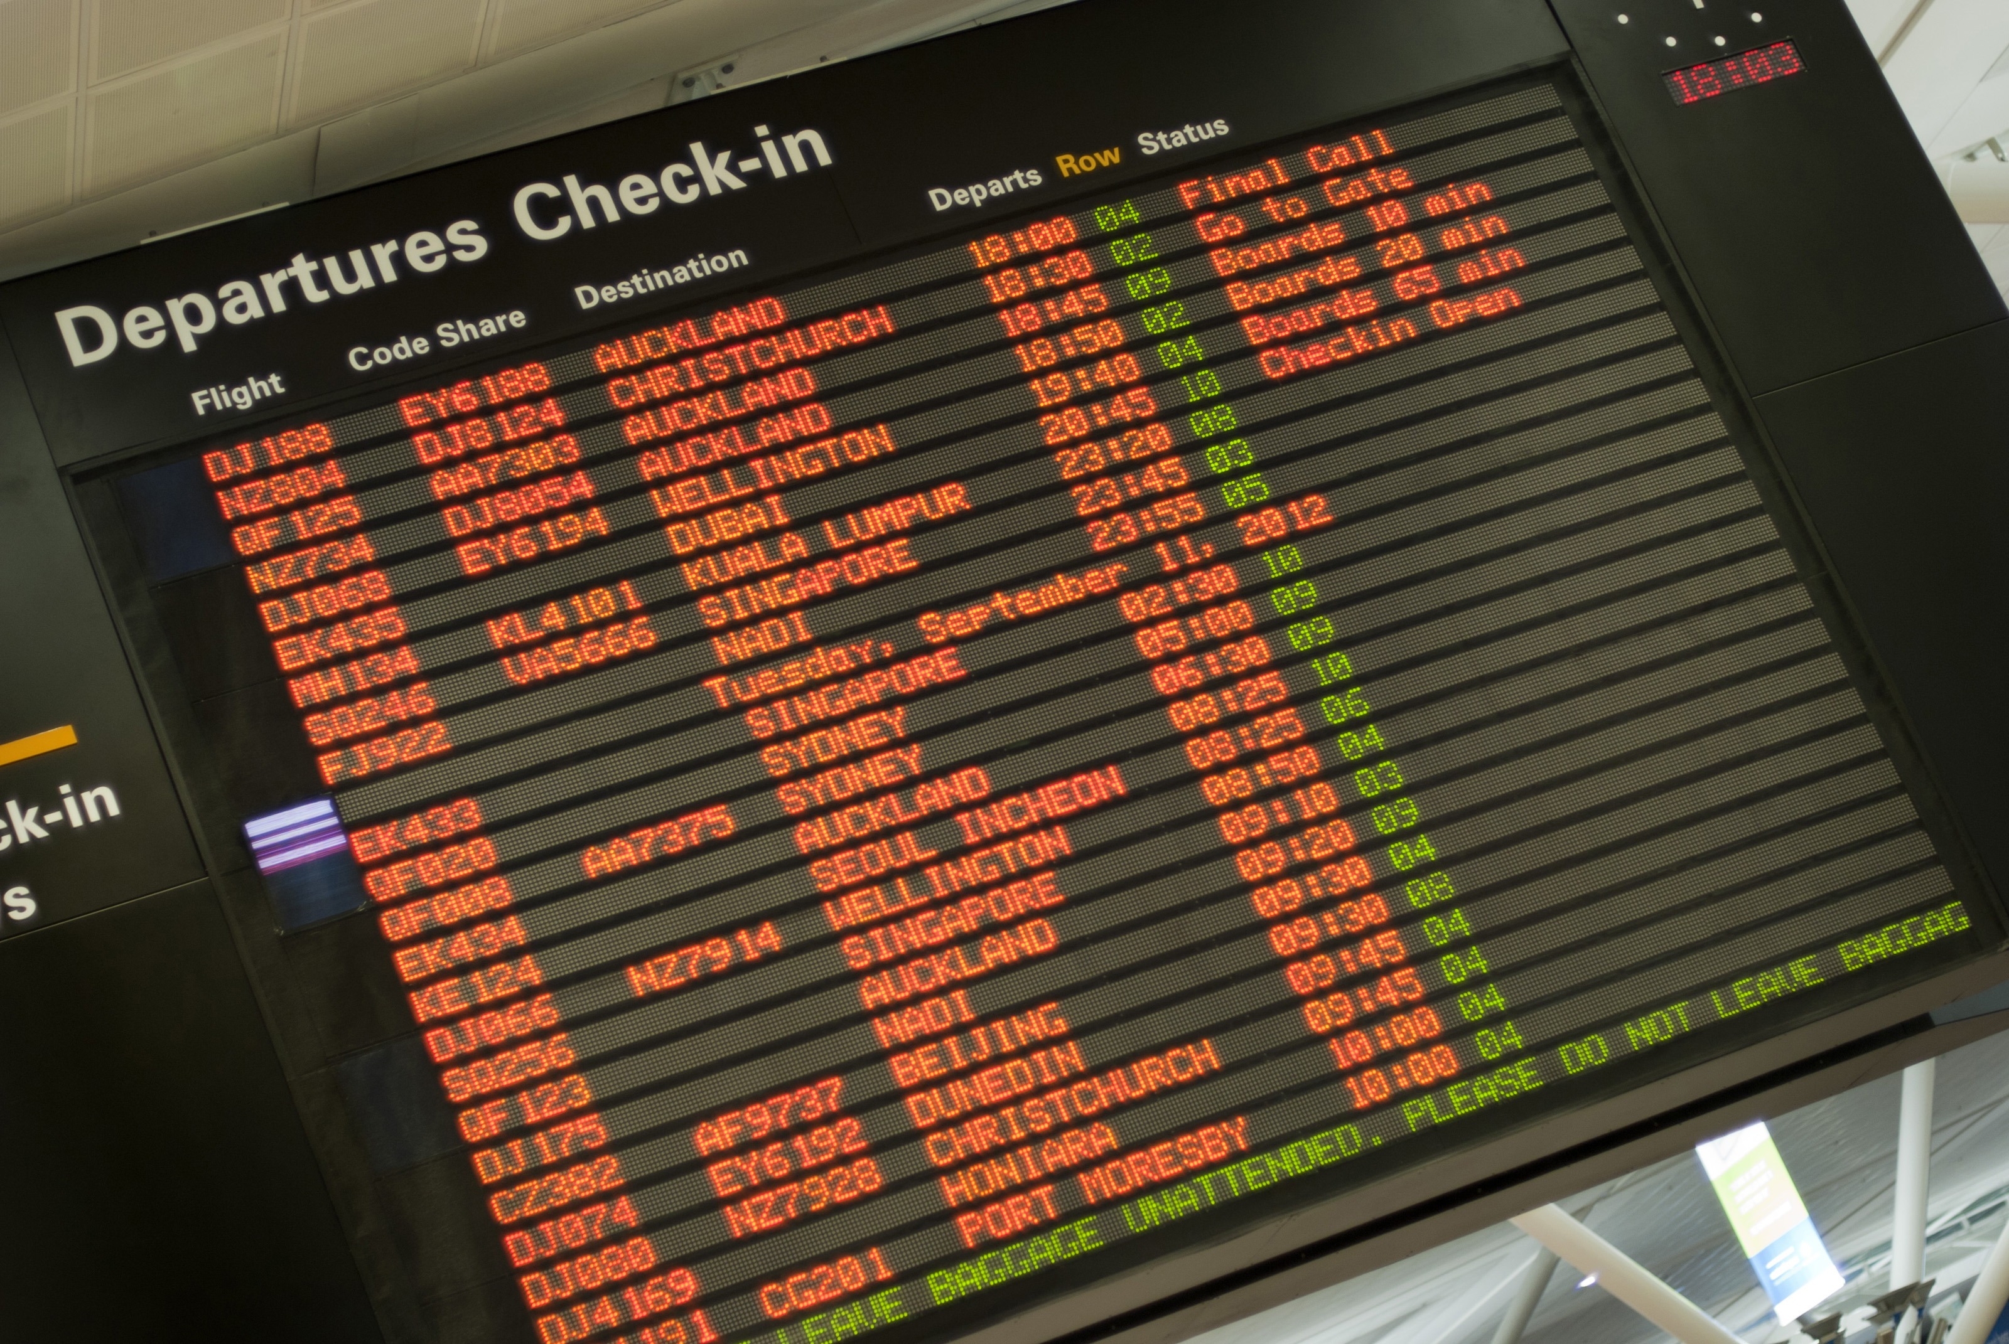
Understanding Routing
Consider a passenger traveling from Pune to Sioux Falls, USA
Pune
Mumbai
San Francisco
Chicago
Sioux Falls
Hop Number | From | To | Passenger’s View
1 | Pune | Mumbai | Pune-Sioux Falls
2 | Mumbai | San Francisco | Pune-Sioux Falls
3 | San Francisco | Chicago | Pune-Sioux Falls
4 | Chicago | Sioux Falls | Pune-Sioux Falls

Slide 15

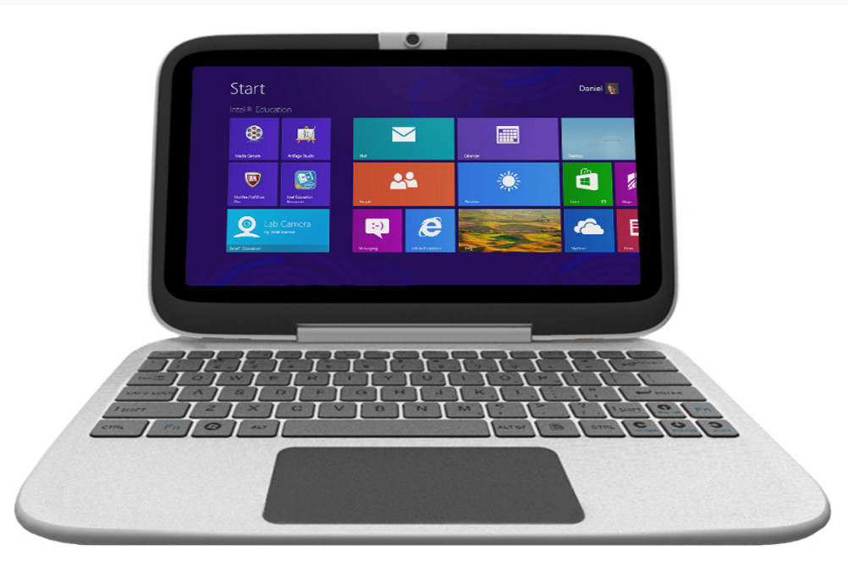

Understanding Routing
Consider a datagram/packet going from computer A to computer B
A
R1
R2
R3
B
 | Data Link Layer | View
Hop Number | From | To | IP View
1 | A | R1 | A-B
2 | R1 | R2 | A-B
3 | R2 | R3 | A-B
4 | R3 | B | A-B

Slide 16
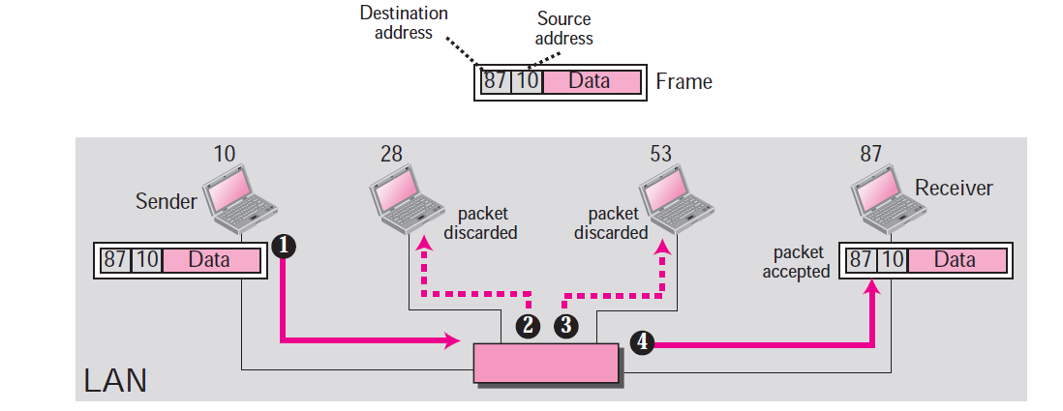
MAC Addresses and LAN

Slide 17
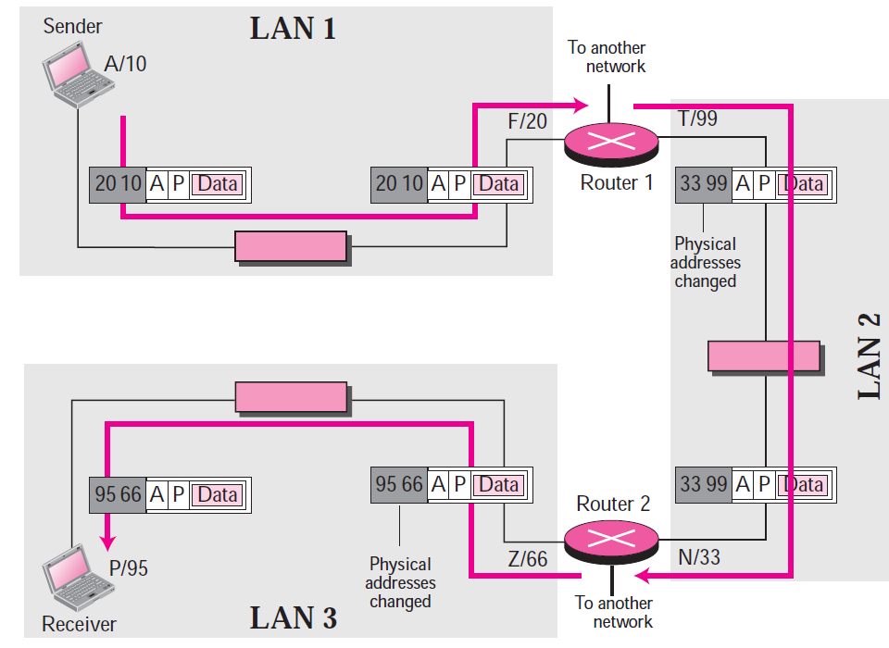
IP Addresses and the Internet

Slide 18
Sessions 6 and 7: IP Addressing and Routing

Slide 19
IP Address
An IP address has two parts:
Network Id: Identifies which network it belongs to
Host Id: On a given network, what is the host number
Examples:
This notation is called as dotted decimal notation
Some portion of the network id is reserved to indicate class of IP address
Hence, this is called as classful addressing
14.22.130.89
143.1.99.204
193.56. 78.21

Slide 20
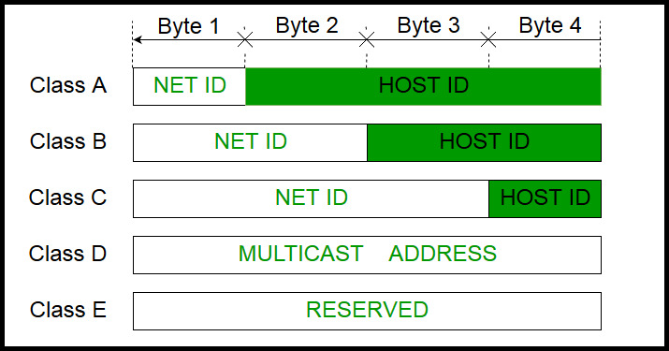
IP Address Classes

Slide 21
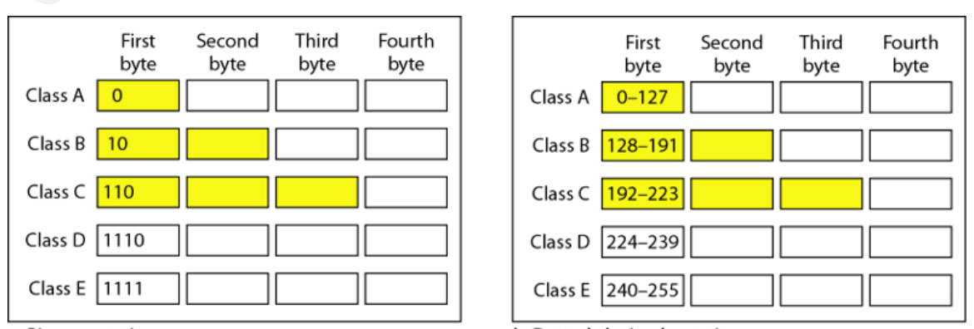
Classful Addressing

Slide 22
Classes – How to Determine/Remember? – Three Techniques
Look at the first few bits of the binary value of the network id
First bit 0: Class A
First two bits 10: class B
First three bits 110: class C
Look at the first decimal octet/byte value of the network id
0-127: Class A
128-191: Class B
192-223: Class C
Use the flow-chart on the following slide

Slide 23
Determining Class
First bit = 0?
Yes
Class A address
No
Second bit = 0?
Yes
Class B address
No
Third bit = 0?
Yes
Class C address
No
Fourth bit = 0?
Yes
Class D address
No
Class E address
Notes:
23

Slide 24
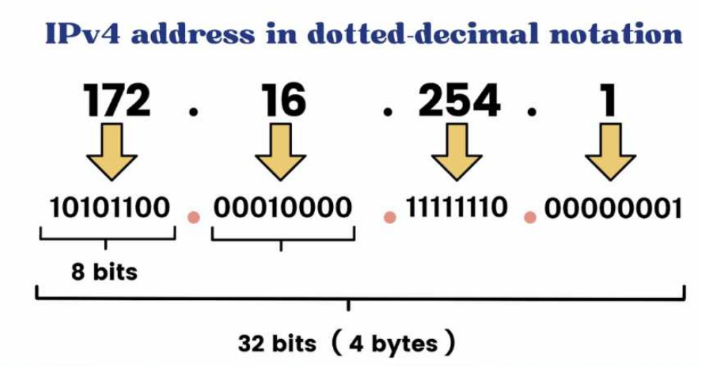
Dotted Decimal Notation

Slide 25
Masking
Hide the host id part of an IP address
Retain the network id part
This is called masking (the host id part)

Slide 26
Calculation
The address whose network ID we want
134.45.78.2
Default mask for class B (since the address above is from class B)
AND
255.255.0.0
Network ID for the address
134.45.0.0

Slide 27
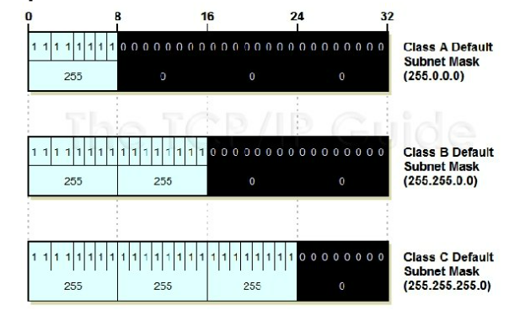
Default Mask

Slide 28
Default Masks
Class | Mask in Binary | Mask in dotted-decimal
A | 11111111 00000000 00000000 00000000 | 255.0.0.0
B | 11111111 11111111 00000000 00000000 | 255.255.0.0
C | 11111111 11111111 11111111 00000000 | 255.255.255.0
Notes:
28

Slide 29
Masking Examples
Given an IP address of 23.56.7.91, find the network address.
Given an IP address of 132.6.17.85, find the network address.
Notes:
29

Slide 30
Private/Local/Internal IP Addresses
The following ranges of IP addresses are reserved as private/local/internal IP addresses, and they cannot be assigned to a computer on the Internet as a public/external IP address
Class A: 10.0.0.0 to 10.255.255.255
Class B: 172.16.0.0 to 172.31.255.255
Class C: 192.168.0.0 to 192.168.255.255

